Slide 1
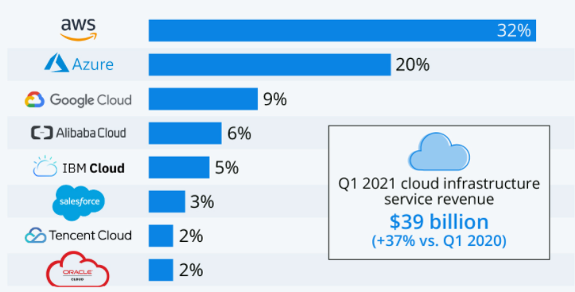
Top Server & Cloud MSS%
Company | 2020Q2 | 2020Q3 | 2020Q4 | 2021Q1 | 2021Q2
T1. HPE/H3C (a) | 14.80% | 15.90% | 15.80% | 15.80% | 15.70%
T1. Dell Technologies | 13.80% | 16.60% | 15.30% | 16.90% | 15.60%
3. Inspur/Inspur Power Systems (b) | 10.50% | 9.30% | 8.50% | 7.20% | 9.40%
4. Lenovo | 6.10% | 5.80% | 5.60% | 6.80% | 7.00%
5. IBM | 6.00% | 3.30% | 7.20% | 5.30% | 5.00%
ODM Direct | 28.50% | 27.80% | 25.20% | 26.20% | 26.70%
Rest of Market | 20.40% | 21.30% | 22.40% | 21.70% | 20.80%
Total | 100% | 100% | 100% | 100% | 100%
Other customers: Supermicro, ODM Direct (Quanta, Foxconn, Inventec, Wistron/Wiwynn, MiTAC, Gigabyte, ASRock), other OEMs (Oracle, Cisco, Huawei, etc)
Top CSP Customers: Google, Amazon, MSFT, FB, Tencent, Alibaba, Baidu, Twitter, Bytedance, JD, Oracle
https://www.statista.com/chart/18819/worldwide-market-share-of-leading-cloud-infrastructure-service-providers/
https://www.idc.com/promo/servers

Slide 2
OEM-ODM Pairing & Approximate Site Volume
ODM | Site | SMT or SI or Both | Segment | Support Tier | OEM1 | OEM2 | OEM3 | Additional OEMs
Quanta | Shanghai | Both | SVR/CSP | 1 | Amazon | Facebook | Google | Intel, Ali, Tencent, QCT
 | Tennessee | SI | SVR/CSP | 2 | Amazon | Facebook
 | Taiwan | Both | SVR/CSP | 1 | Amazon | Facebook | Google
 | Germany | SI | SVR/CSP | 2 | Amazon | Facebook
Compal | Kunshan | Both | SVR | 1 | Dell (66%) | Lenovo (22%) | Intel (12%)
Inventec | Shanghai | Both | SVR | 1 | L10: Tencent | L10: Alibaba | L10: JD | L10: Bytedance, HPE L6: Dell, Lenovo, Baidu
 | Taiwan | Both | SVR/CSP | 2 | Dell | Microsoft | Facebook | Google, AWS
 | Mexico | SI | SVR | 1 | HPE
LCFC | Hefei | Both | SVR | 1 | Lenovo
Lenovo | Mexico | SI | SVR/CSP | 1 | Lenovo | Microsoft | IBM
 | Shenzhen | SI | SVR/CSP | 2 | Lenovo | Alibaba | Tencent
 | Brazil | SI | SVR | 2 | Lenovo
Wistron | Zhongshan | Both | SVR | 2 | Lenovo | Dell | HP | Acer
 | Hsinchu | ? | SVR | 3 | Focusing on AI (Nvidia)
 | Czech Republic | SI | SVR/CSP | 3 | Facebook | Microsoft | Fujitsu
Pegatron | Taipei | SMT | SVR | 2 | Fujitsu - Pu
Foxconn | Shenzhen | Both | SVR/CSP | 2 | Cisco | AWS | NetApp | Oracle, Dell/EMC
 | Nanning (reactive) | Both | SVR | 3 | Oracle | more?
 | Wuhan | Both | SVR | 2 | Dell | HPE | Lenovo | Intel
 | Tianjin | Both | SVR | 1 | Dell (EPDI factory) L6 | Amazon (EODVI factory) L6 | CABG factory : Alibaba (1/3) | CABG: Tencent (30%)/Byt (15%)/HPE (L6)
 | Czech Republic | SI | SVR/CSP | 3 | HPE | Amazon
 | Hungary | SI | SVR/CSP | 3 | Microsoft | Cloud Network Technology
 | Mexico, Guad | SI | SVR/CSP | 1 | Amazon | Cisco
 | Mexico, Juarez | SI | SVR | 1 | Dell | HPE
Huaqin | Shenzhen | Both | SVR/CSP | 1 | Huawei | PowerLeader | Sugon | Hikvision, H3C
Inspur | Shenzhen | SI | SVR | 2 | Tencent | Alibaba
 | Jinan | SI | SVR/CSP | 1 | L10: Tencent | L10: Alibaba | L10: JD | L10: Bytedance, Baidu - L6: Lenovo
 | Suzhou | SMT | SVR/CSP | 2 | Tencent | Alibaba | JD | Bytedance
 | Guiyang | SI | SVR | 2 | Low end projects | Alibaba
 | Hungary | SI | SVR/CSP | 3 | new - ramp delayed due to Covid19
Wiwynn | Taiwan | Both | SVR | 2 | FB,
 | US | SI | SVR/CSP | 3 | Twitter
 | Mexico | Both | SVR/CSP | 1 | Facebook | Microsoft | Twitter
Accept | Brazil | SI | SVR | 2 | Positivo
Dell | Brazil | SI | SVR | 2 | Dell
Blue = MV Planned with these Customers for Skt BR

Slide 3
OEM-ODM Pairing & Approximate Site Volume
ODM | Site | SMT or SI or Both | Segment | Support Tier | OEM1 | OEM2 | OEM3 | Additional OEMs
Flextronics | Brazil | SI | SVR/CSP | 2 | HPE | Cisco | Google
 | Hungary | SI | SVR | 3 | Lenovo
 | Mexico | SI | SVR | 3 | Cisco
Hyve | UK - Telford | SI | SVR/CSP | 3 | Amazon
 | US - Fremont | SI | SVR/CSP | 3 | Amazon
 | Wuxi (PRC) | SI | SVR/CSP | 3 | Amazon
Jabil | SC, USA | SI | SVR/CSP | 2 | Amazon
Ingrasys | Elsalto, MX | SI | SVR/CSP | 2 | Amazon | Microsoft
Nypro | Ireland | SI | SVR/CSP | 2 | Amazon
ZT | New Jersey | SI | SVR/CSP | 2 | Amazon | Microsoft
Cloud Network Tech | Houston, TX | SI | SVR/CSP | 3 | Oracle
Nanning Fugui Precision Indst. | Nanning China | SI | SVR/CSP | 3 | Oracle
NSG Tech | San Jose, CA | SI | SVR/CSP | 3 | Oracle
Supermicro | San Jose, CA | SI | SVR/CSP | 1 | Supermicro
 | Netherlands | SI | SVR/CSP | 2 | Supermicro
 | Taiwan | SI | SVR/CSP | 2 | Supermicro
Cowin Worldwide Corp | Hong Kong | SI | SVR/CSP | 3 | Microsoft
Siemens | Germany | SI | SVR/IOTG | 1 | Broad Market
Congatec | Germany | SI | SVR/IOTG | 2 | Broad Market
Kontron | Germany | SI | SVR/IOTG | 2 | Broad Market
Bechoff | Germany | SI | SVR/IOTG | 3 | Broad Market
Tyan | US | SI | SVR/CSP | 2 | Twitter
H3C | Hangzhou | SI | SVR/CSP | 2 | Baidu | Alibaba | Tencent | H3C
Mitac (Monitoring only) |  |  |  |  | PCSD - Intel

